Slide 1

MALLA REDDY COLLEGE OF ENGINEERING
THE IDEABRIDGE -
AI HACKDAY 2K25
DOMAIN : HEALTH CARE
DEPARTMENT : COMPUTER SCIENCE AND ENGINEERING
TEAM LEAD NAME : T JATHIN REDDY [23Q91A05AW]
TEAM MEMBER 1 : A RAJASHEKAR REDDY [23Q91A05J6]
TEAM MEMBER 2 : B UMA MAHESHWAR REDDY [23Q91A05D8]

Slide 2
AI POWERED VIRTUAL HEALTH ASSISTANT
TRANSFORMING ROUTINE HEALTHCARE MANAGEMENT

Slide 3
Problem : Design a website with features like Appointment Scheduling and Reminders, Emergency Assistance Integration, Personalized Diet Plans, Nutrition Tracking and AI Chatbot for Medication Guidance. The system offers a comprehensive health management solution: 1. AI chatbot for guidance on medication intake. 2. Customizable diet plans and nutritional recommendations. 3. Real-time appointment and schedule management. Prototype: Interactive, responsive website with AI integration.
Problem statement

Slide 4




IMPLEMENTATION
.
.
Integration of Appointment Scheduling and Remainders
Development of AI powered Health Monitoring Systems
Emergency Assistance ,diet plans and chatbot functionality
Deployment on a user-friendly web platform

Slide 5
FLOW CHART:
Start
AI chatbot Assistance
Appointment
Diet plan
Set Reminders
Schedules
Emergency
Feedback
AI chatbot
Select your plan
Medicine or appointment
Information
Information
Display schedules
Select Doctor
Health condition
Date and time
Emergency type
Feedback
Book appointment
Get your diet
Set remainder
Submit
Request

Slide 6
RESOURCES REQUIRED
Web Application Development :
Frontend Technologies : html, Css, Javascript
Interactive Features : Chatbot , Dynamic Appointment Form.
Integration of External Links : Google Maps
Custom Functions : Show appointment form , toggle chatbot
Static Assets : Background images, styles, and internal navigation
Further Development:
Backend Integration : PHP, Node.js, or Python and Integrate a database like MySQL
API for Chatbot : API like OpenAI

Slide 7
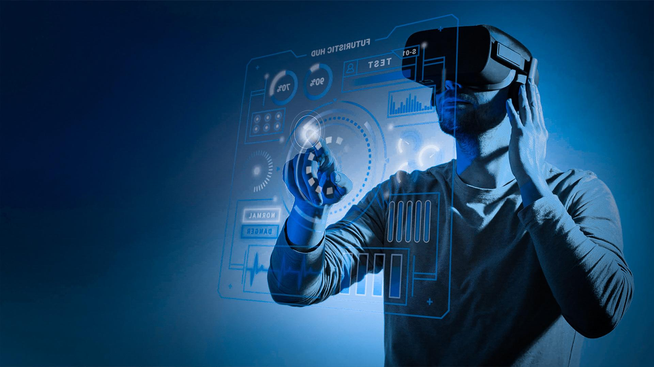

Conclusion: By leveraging modern web development techniques, this platform addresses the challenges of accessibility and convenience in healthcare. Future enhancements, such as backend integration and a more advanced chatbot, can further improve the system's functionality and user experience.

